Slide 1
weather checking habits
Survey Results Summary and Interpretation
PRESENTED BY: CARMEN CHIRITA
DECEMBER 2017

Slide 2
Survey layout
Question | Available Answer Options
Q1: Do you typically check a daily weather report? | Yes or No (the only question on this survey which requires a mandatory answer; choose from list)
Q2: How do you typically check the weather? | List of provided options, including "A specific website or app (please provide the answer)”
Q3: A specific website or app (please provide the answer) | Free text
Q4: If you had a smartwatch (like the soon to be released Apple Watch), how likely or unlikely would you be to check the weather on that device? | List of provided options (1-4 scale: "Very Likely", "Somewhat Likely", "Somewhat unlikely", "Very unlikely”)
Q5: Age | List of provided options (18-29, 30-44, 45-59, 60+)
Q6: What is your gender? | Female, Male
Q7: How much total combined money did all members of your HOUSEHOLD earn last year? | Provided ranges to select from, and “Prefer not to answer”
Q8: US Region | List of provided options
The source of the data is a Survey Monkey Audience poll commissioned by FiveThirtyEight and conducted from April 6 to April 10, 2015.

Slide 3
Context in which the questions were asked Is The Weather Company in a tough spot, or is there light at the end of the tunnel?
2015
Crowded weather forecasting market (over 350 players; new Big Data players-e.g. IBM)
The weather wars were heating up (The Weather Channel had major contract disputes: 2010-Dish Network; 2014-DirecTV)
Major threat to its core business: fees collected from TV providers for carrying its channel
But The Weather Channel was still a market leader, bold about the future and redefining itself as The Weather Company
Looking for opportunities to leverage its strong brand in adjacent markets (smart phone/smartwatch apps)
Had a successful foray in the smart watch market with an app for Pebble in 2014
Just reached an agreement with Apple to replace Yahoo as their source of weather data
WSJ article about Verizon FiOS dropping the station because of “customers’ growing use of online sources and apps to look up weather information” and making a strong case “Storm clouds are gathering over the Weather Channel”.
Survey was reportedly an attempt to better understand how many people get their weather from The Weather Channel station, if it is true that customers are flocking to apps (in particular the default app on the phone) and the web, and whether this is a generational problem (i.e. younger audience gravitates from The Weather Channel station to other platforms)
Also insights about specific website and app utilization and interest in weather app on a smartwatch
Notes:
SOURCE OF MARKET INFO DATA:
http://fortune.com/2014/02/11/the-weather-channels-cable-fight-is-the-tip-of-the-iceberg/ (Feb 2014) ; 2015 contract dispute Verizon who replaced them w AccuWeather
Recently acquired two competitors: Weather Underground and Weather Central
Accuweather remained its largest traditional competitor
https://en.wikipedia.org/wiki/The_Weather_Channel (history)
Verizon Fios, also known as Fios by Verizon, is a bundled Internet access, telephone, and television service that operates over a fiber-optic communications network with over 5 million customers in nine U.S. states. Wikipedia

Slide 4
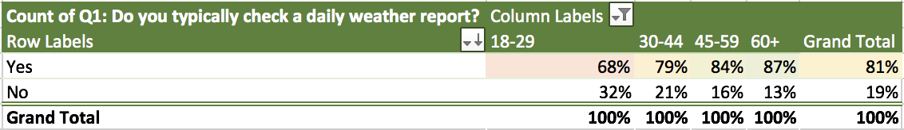
Most people check the weather daily
Q1
Over 80% of survey respondents check the weather daily
More older respondents tend to check the weather daily
Slightly more of the women (> 4 out of 5) check the weather daily than the men (approx. 3 out of 4)
Respondents from regions with bad or changing weather (e.g. New England) tend to check the weather more than those from regions with nice weather (e.g. Pacific)

Slide 5
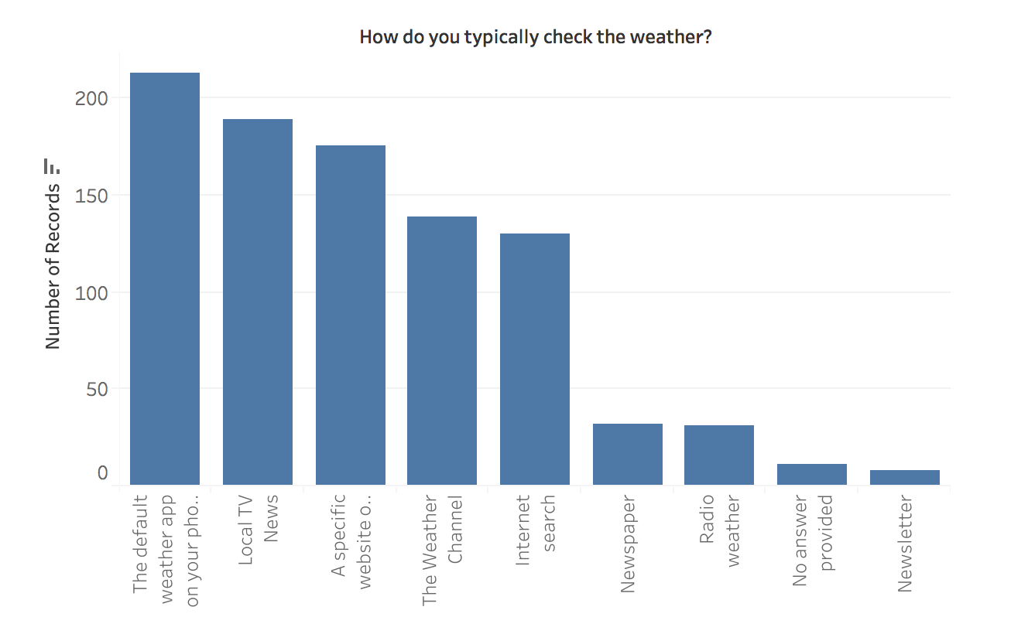
15% of respondents get their weather from The Weather Channel station 23% of respondents use the default weather app on their phone
Q2
To check the weather, respondents mostly use the default app on the phone, local TV news, a specific website, The Weather Channel, or an internet search
Some variability with respondent age and between daily and less frequent weather checkers
23%
20%
n = 928
19%
15%
14%
3%
3%
1%
1%

Slide 6
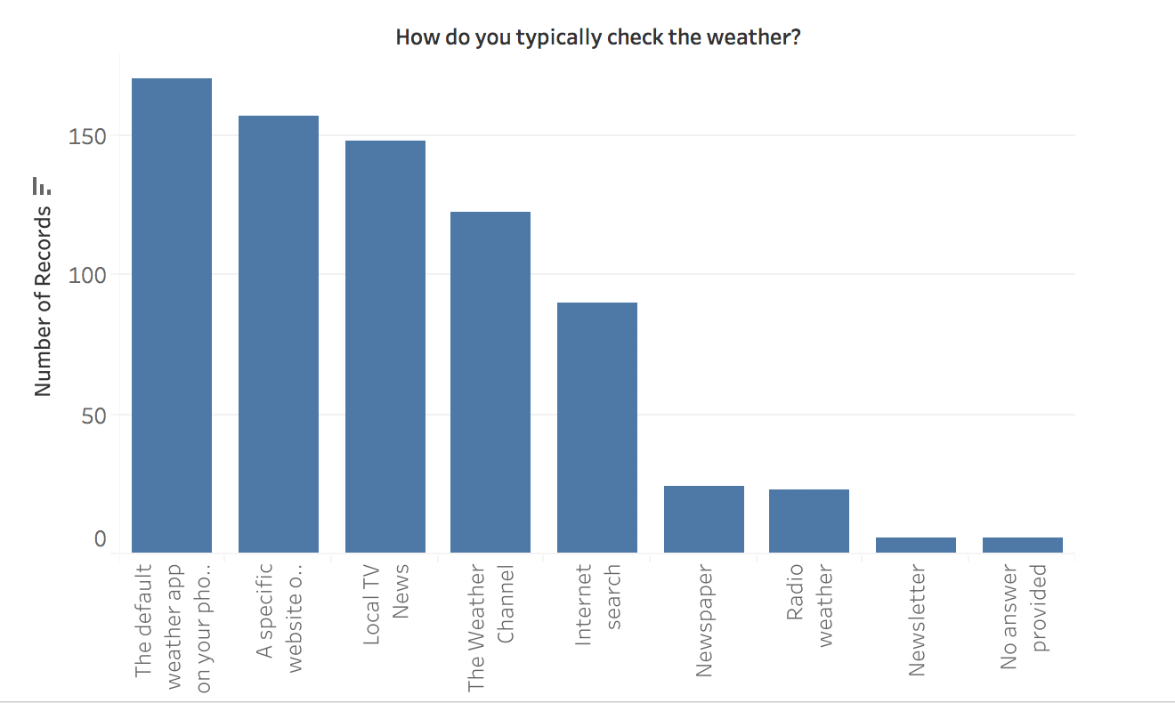
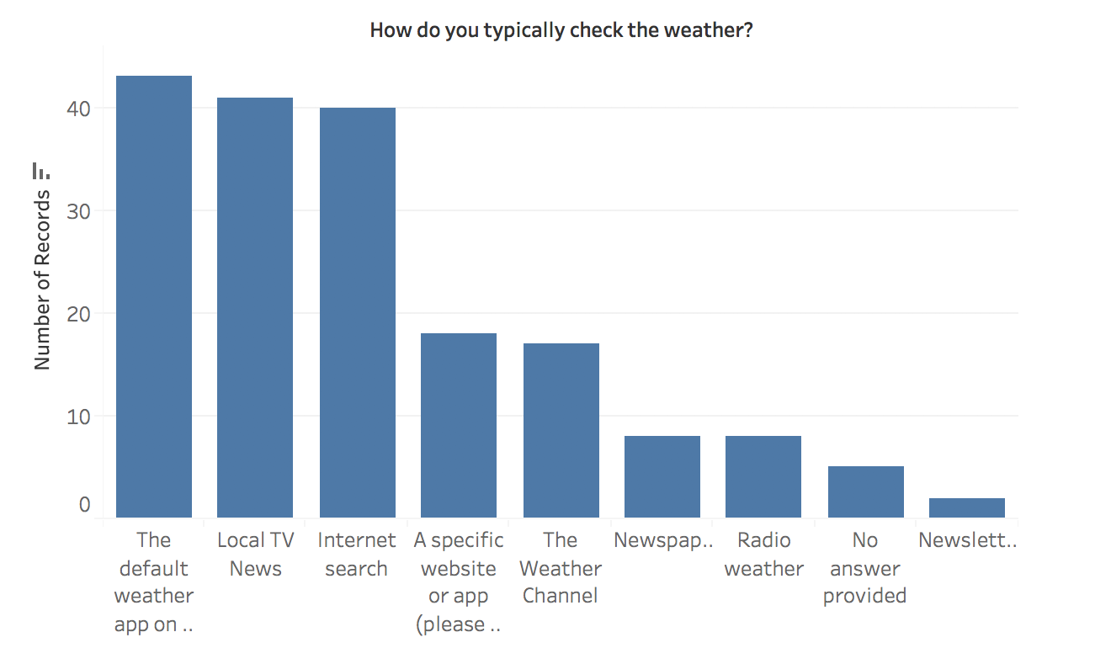
15% of respondents get their weather from The Weather Channel station 23% of respondents use the default weather app on their phone
Q2
Variability between daily and less frequent weather checkers
Shifts in specific website utilization versus internet search
23%
24%
23%
n = 182
23%
n = 928
21%
20%
n = 746
23%
20%
Daily checker
Less frequent checker
19%
All
16%
15%
14%
12%
10%
9%
3%
3%
4%
4%
3%
3%
3%
1%
1%
1%
1%
1%

Slide 7
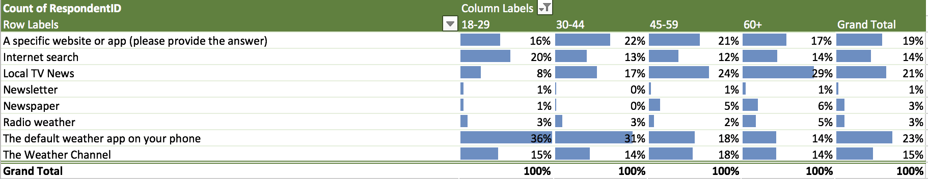
15% of respondents get their weather from The Weather Channel station 23% of respondents use the default weather app on their phone
Q2
Generational variability
The proportion of young adults watching The Weather Channel is 15%, same as overall population
Young adults watch local news the least and use the default weather app the most, regardless whether checking weather daily or not
The default phone app is the most preferred way to check weather for those 44 and younger
Local news is the most preferred way to check weather for those 45 and older
Notes:
A higher proportion of younger respondents generally use the default app on their phone, while higher proportion of middle age and older adults rely on local TV news

Slide 8
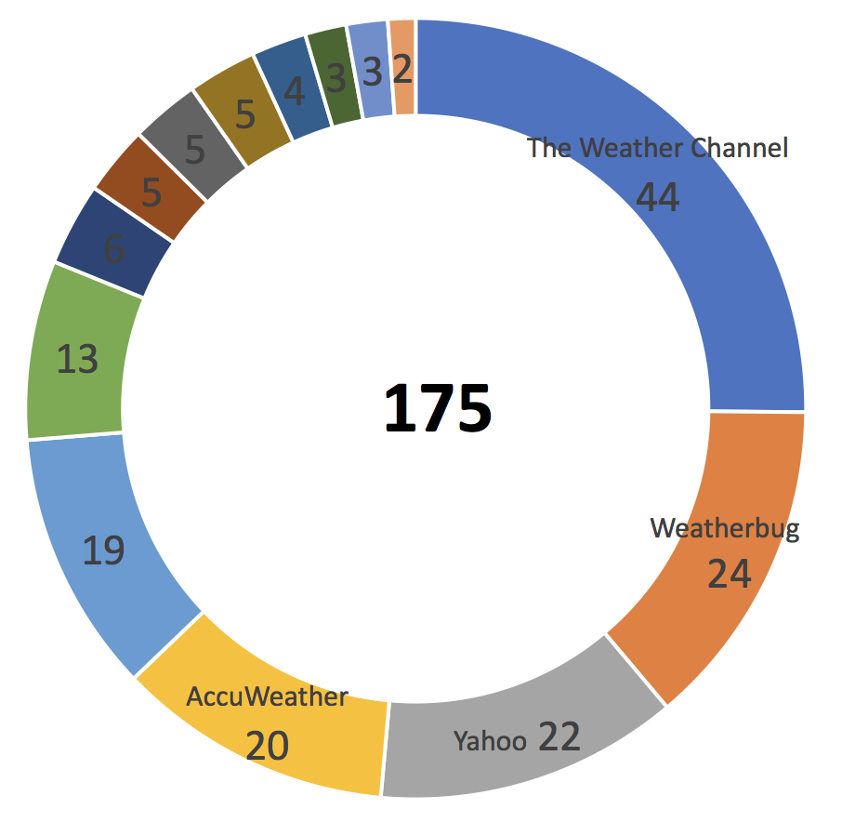
What are the weather forecast sources behind the websites and apps specified by the survey respondents?
Q3
The most common source of weather information (via website/app) the respondents use is The Weather Channel,
** An additional 139 respondents (15%) specified The Weather Channel as source of their weather info per the prior question (looking beyond web and apps, including TV & other media)
25%
7%
n =
14%
11%
11%
14%
Notes:
followed by the Weatherbug, Yahoo (weather info provider for Apple devices at the time), and Accuweather

Slide 9
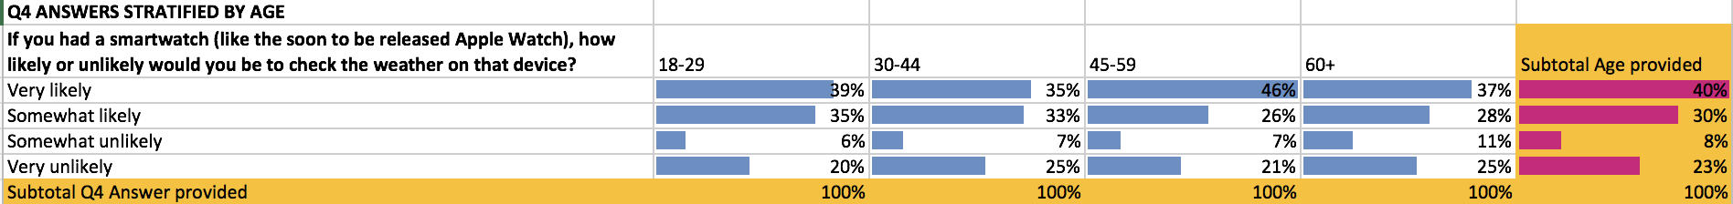
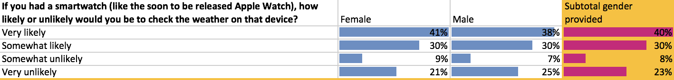
70% of respondents said they would be Very Likely or Somewhat Likely to check the weather on their smartwatch, if they had one
Q4
The youngest generation had the highest interest, while those 60+ had the least inclination to do so
Very Likely or Somewhat Likely 74%. 68%. 72% 65% 70%
The strong interest in checking the weather on a smartwatch also held across gender, income brackets, and US geographic regions

Slide 10
In summary
The Weather Channel prospects are not all bad, as portrayed by the WSJ article
Although the most preferred way to check the weather is now the default phone weather app, The Weather Channel Station is still used 15% of the time and this holds with the youngest demographics
When checking the weather via a specified website or app, the forecast is sourced by The Weather Channel provided data 25% of the time
A vast majority of respondents would likely check the weather on their smartwatch, if they had one
The Weather Company just had a successful foray in the smartwatch market with an app for Pebble in 2014
And they just reached an agreement with Apple to replace Yahoo as their source of weather data
Apple was at the time the largest smartphone provider in the US
Apple was already taking the emerging smartphone market by storm

Slide 11
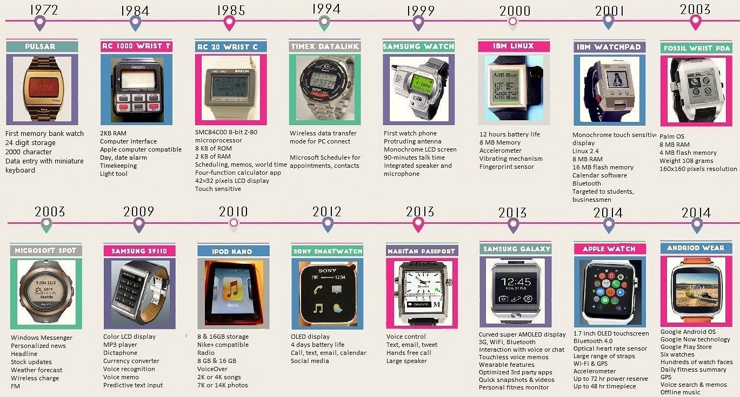
If we were The Weather Company, what questions we would ask next, and where would we want to go from here?
Learn more about desirable weather features on a smartwatch?
Learn more about any existing or emerging smartwatch weather apps?
Collect info to shape business case for further investments or collaborations in smartwatch or other wearables technology?
Size and qualify opportunity (SWOT or Scenarios analysis)
Smartwatch weather app market size/growth potential
Market share/penetration potential
Identify early adopters
Build or license decision

Slide 12
Weather Channel app was launched on a smartwatch
TECHNOLOGY
The Weather Channel Storms The Smartwatch
Launches Weather App For Pebble Platform 8/06/2014 2:15 PM Eastern
The Weather Channel said it is powering a new weather app for the Pebble smartwatch platform that providers the wearer with current weather conditions and access to a three-day forecast that is given with a shake of the wrist.
“Using best-in-class forecasts from The Weather Channel, this app gives you the basic weather information you want, at a glance and where you need it,” said Mike Finnerty, senior vice president and general manager of platform products and distribution at The Weather Company, parent to The Weather Channel, in a statement. “The launch screen shows your current time and temperature, and then shake your wrist to get a three-day forecast.”
The new app is one of more than 3,000 that are now available for Pebble-made
waterproof smartwatches, which range in price from $150 to $249 and tout a battery
life of five to seven days.
Source: Multichannel News

Slide 13
Apple Watch
Forbes: Apple will instantly become the major player in the smartwatch market at 12:00:01 AM on April 24 [2015]. Basically the second the Watch is officially available.
Apple Watch shipments grew nearly 60% year-on-year in the first quarter of 2017
Apple is now the biggest wearables vendor by market share
The technology giant clinched the top spot for the first time since the third quarter of 2015.
Notes:
https://www.forbes.com/sites/dougolenick/2015/04/24/apple-watch-launch-is-one-for-the-history-books/#5338edff37f2
On 9 September 2014, Apple Inc. announced its first smartwatch called Apple Watch to be released in early 2015. ... However, others praised Apple for creating a potentially fashionable device that can compete with "traditional watches," not just the smartwatch industry in general. (Source: Wikipedia)
https://www.forbes.com/sites/dougolenick/2015/04/24/apple-watch-launch-is-one-for-the-history-books/#5338edff37f2
https://www.cnbc.com/2017/05/05/apple-watch-fitbit-shipments-market-share-q1-2017.html

